Slide 1


Gabriel Ristow Cidral
IOT Analytics
The value of sub-metering systems – Final delivery
Notes:
Sub metering systems are the fundamental tool to Smart homes and the homes of the future

Slide 2


Recap
Home developer
Final user
Added value
Differentiation from competition
User Dashboard
Control, save, predict
Notes:
Energy saving from knowledge of spending
If you understand how your clients are using your product, you can improve your product

Slide 3


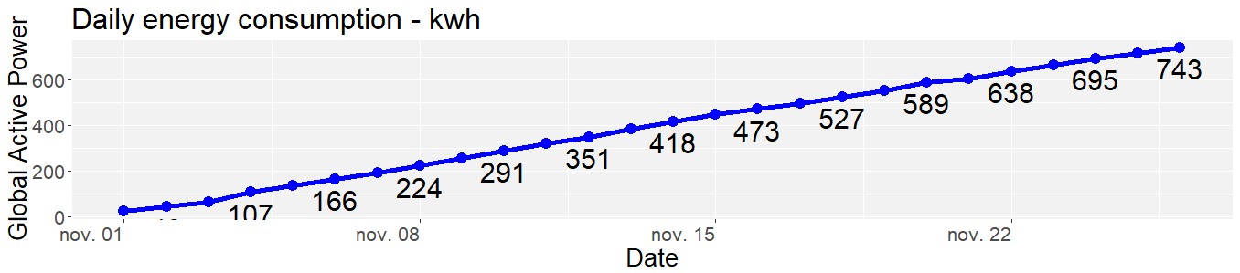
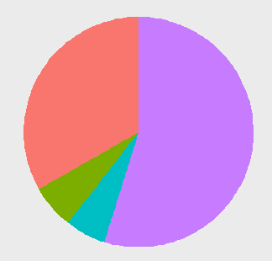


My Home
My Home
Tips to save
Predictions
This month
This Year
Historical
Today
Consumption by sub meter
Compare
Other
4% less than last month
6% more than same month last year
33%
Waterheater & airconditioner
55%
6%
Laundry
6%
Kitchen
Last update: 26/11/2010 – 21:02:00

Slide 4
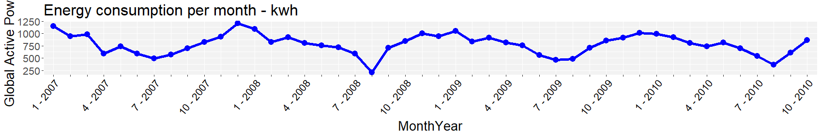
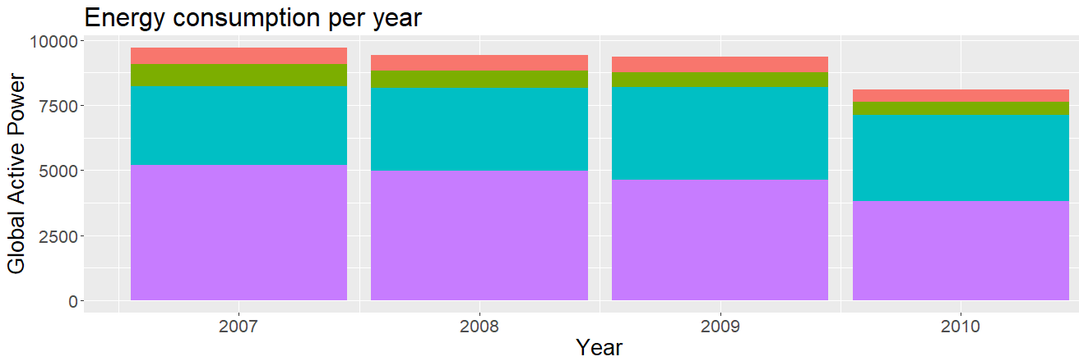
My Home
My Home
Tips to save
Predictions
This month
This Year
Historical
7%
6%
6%
9%
7%
6%
6%
Kitchen
31%
33%
38%
6%
41%
Laundry
Waterheater & airconditioning
53%
53%
49%
47%
Other
Last update: 26/11/2010 – 21:02:00
Notes:
Highly correlated with temperature

Slide 5

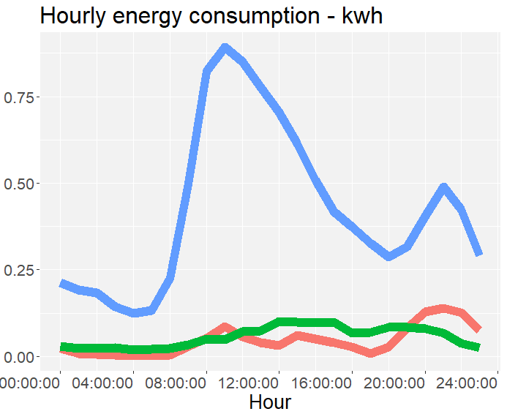
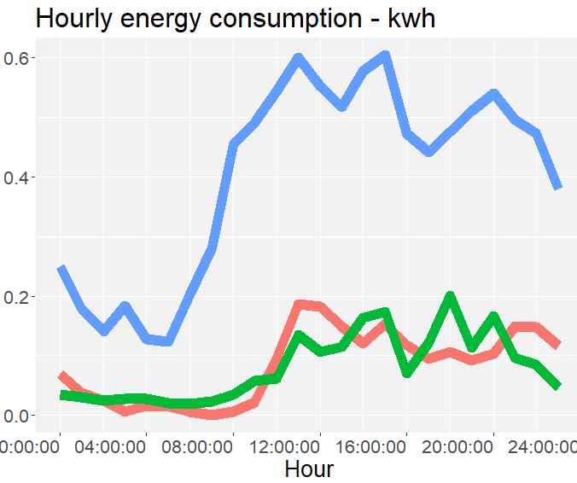
My Home
My Home
Tips to save
Predictions
Rates in France increase if several equipments are used at the same time
Weekday
Weekend
Waterheater & airconditioning
Laundry
Kitchen
Last update: 26/11/2010 – 21:02:00

Slide 6
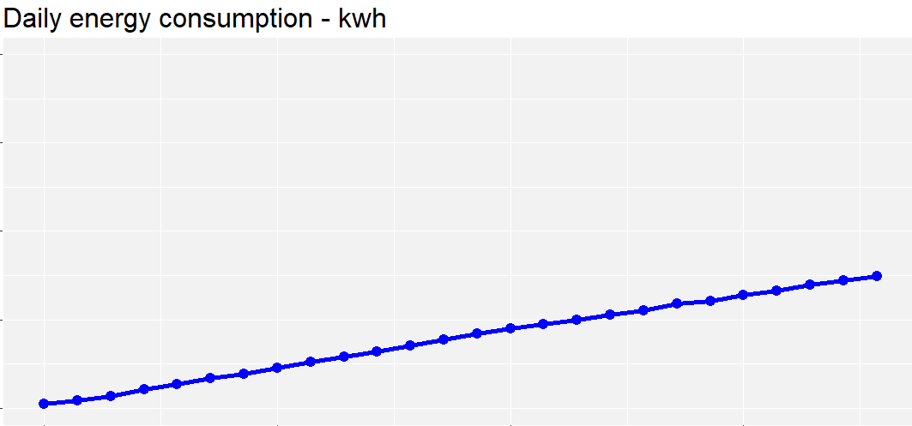
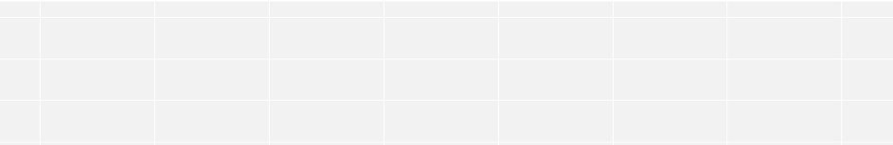
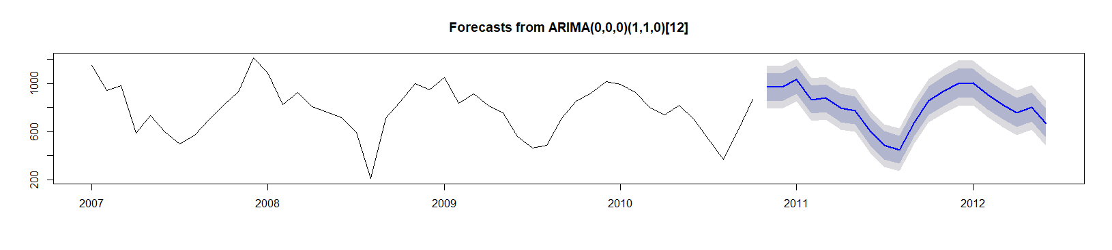
My Home
My Home
Tips to save
Predictions
My current bill
2,000
1,950 kwh
1,500
1,000
743 kwh
973 kwh
500
0
Today
Nov. 01
Nov. 08
Nov. 15
Nov. 22
Nov. 30
Dec. 31
Projection
Last update: 26/11/2010 – 21:02:00

Slide 7
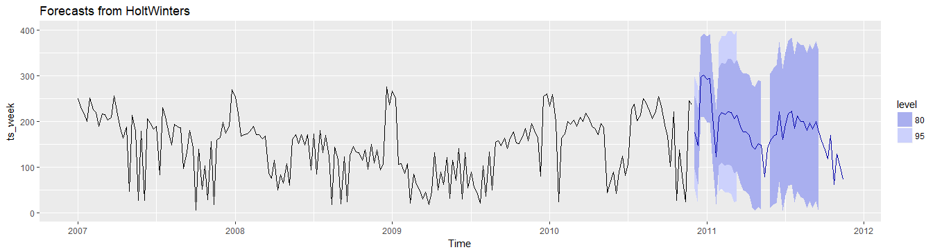
Forecasting methodology
 | ARIMA (autoregressive integrated moving average) |  | Holt Winters
 | Monthly | Weekly | Monthly | Weekly
Mean absolute percentage error | 9 | 69 | 12 | 62
Data profile:
Stationary
Seasonal additive
Monthly forecast
Weekly forecast

Slide 8
Thank you!

Slide 9
Recommendations

Slide 10
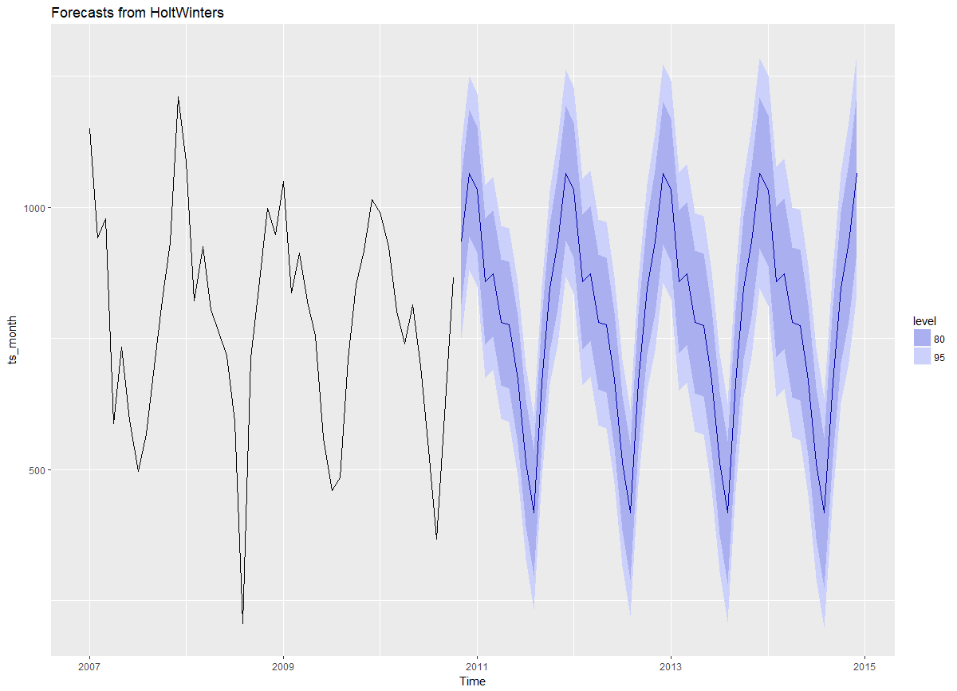

Slide 11
HOW TO SAVE

Slide 12
fORECASTING

